Slide 1
AI CHATBOT
AI-MINI PROJECT

Slide 2
TEAM MEMBERS
ASHISHREDDY
SUBHAYAN
SHAIK TOUSIF

Slide 3
OBJECTIVE OF THE PROJECT
The AI chatbot is a simple automatic communicating system for a college inquiry. Here, the user has to place their queries as input, and the system bot replies according to the question. This system can play a very convenient and time-saving role in delivering the required information about the college to those who inquiry.

Slide 4
Steps:
Import and load the data file
Preprocess data
Create training and testing data
Build the model
Predict the response

Slide 5
Algorithms :
Decision Trees
Support Vector Machines - classification and regression analysis
Long Short Term Memory (LSTM)
Recurrent Neural Networks
Natural Language Processing (NLP).
concerned with giving computers the ability to understand text and spoken words in much the same way human beings can.

Slide 6
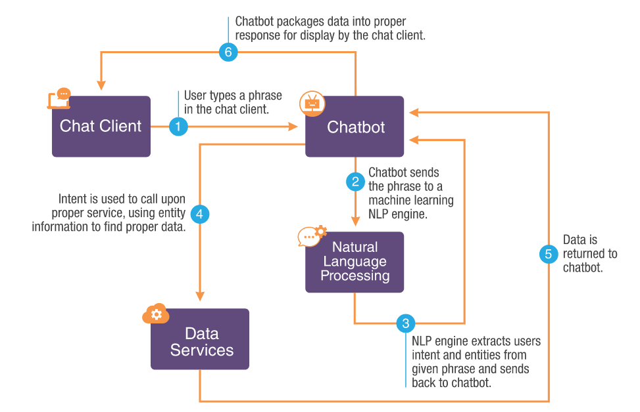
WORKFLOW

Slide 7
MODULES OF THE PROJECT
s.no | Name | Reg no. | Module
1 | THUMU ASHISHREDDY | RA1911003010686 | Python Main Code
2 | SUBHAYAN MUKHERJEE | RA1911003010672 | Training Data
3 | SHAIK TOUSIF | RA1911003010673 | Json files and Error Checking

Slide 8
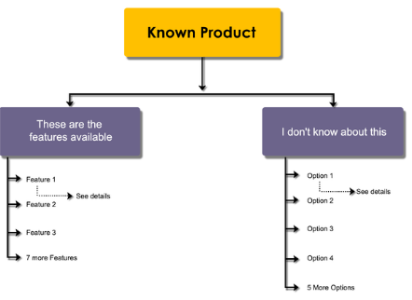
Output deliverables
It allows the user to provide suitable queries about the college and replies with suitable answers.

Slide 9
SCHEDULE OF THE PROJECT
S.no | Modules | Scheduled date
1 | Building code | 4-04-22
2 | Training the data | 8-04-22
3 | Importing and Constructing JSON files | 10-04-22
4 | XML Development | 12-04-22
5 | Testing and Finishing | 15-04-22

